Slide 1
CSC 690 Final Project Presentation
Zeyuan Cai, Fengze You

Slide 2
Introduction
Goal
MyBudget App
Three views in budget app
Login Page
Account Book Page
Addrecord Page

Slide 3
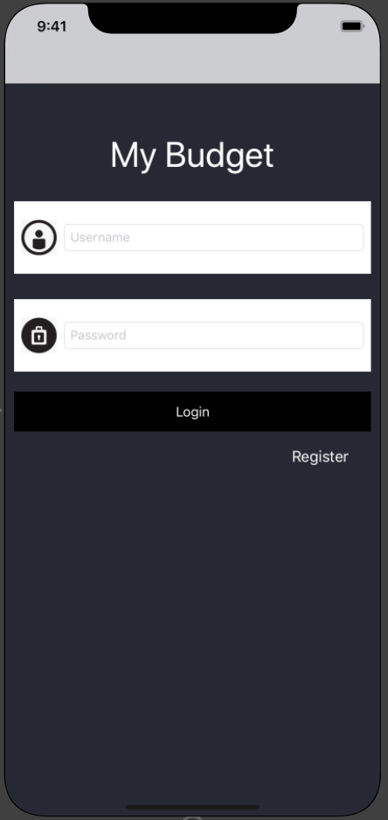
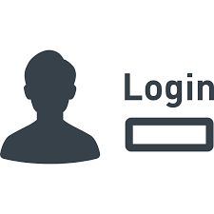
Login Page
Username
Password
Register:
Once you click register button, it will create your account information in local file, and
Also store all data in there.

Slide 4
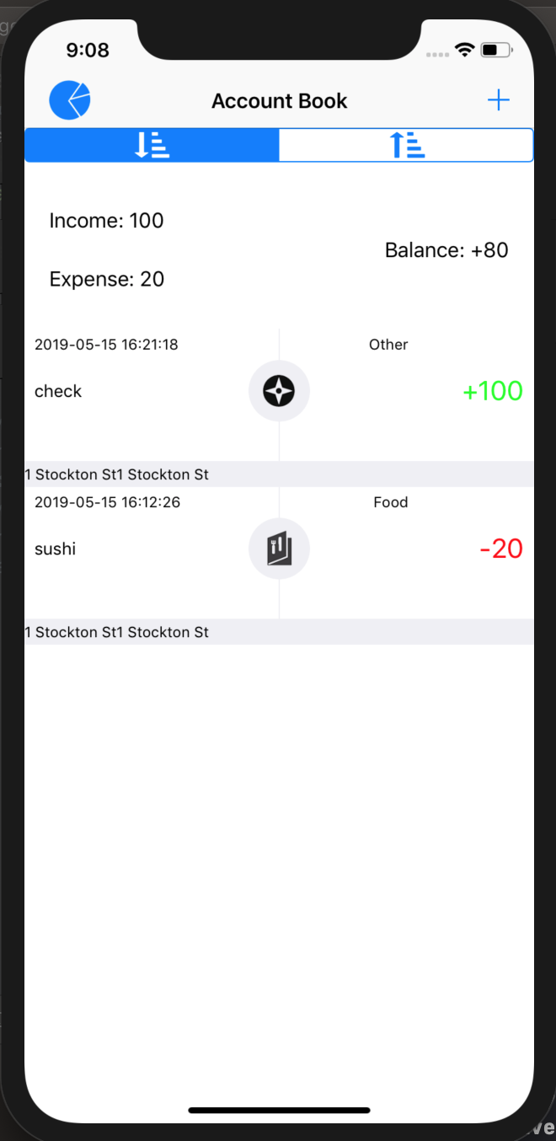


Main Page- Display all the records
Tracks total Income/Balance/Spend
Pie Chart
Sort according time (ascending/descending)
Display the category icon for each type
Display location/time/amount/notes

Slide 5
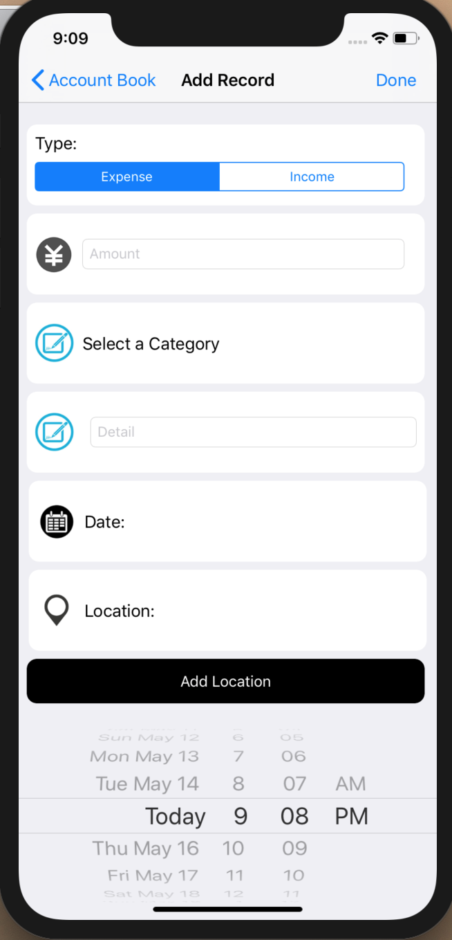

AddRecord Page
Add daily Spending/Incoming to the record
Add the amount of money you spend
Select Different Category Spending
Add what time did you spend the money
Add where did you spend the money

Slide 6
Implementation

Slide 7
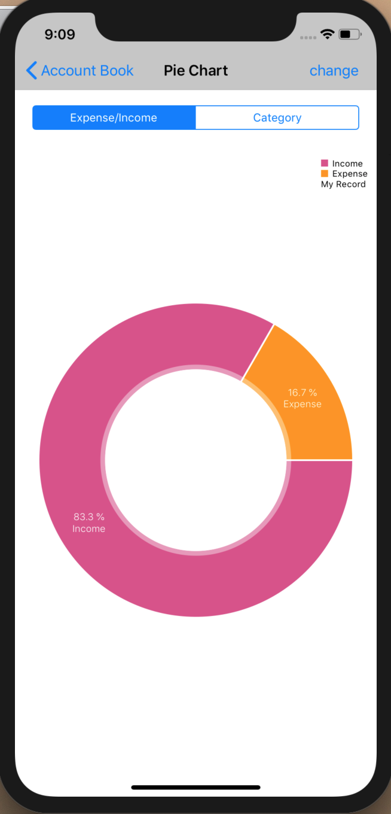
Pie Chart Reference: https://www.youtube.com/watch?v=9F6D4KT5hJ8 https://github.com/danielgindi/Charts
Core Features:
Dual Axes (both x- and y-axis)
Predefined color templates
Income -pink
Expenses -orange
Create multiple segments for pie chart
This CGContextAddArc() function will let you create multiple segments for your pie chart by drawing an arc for each segment of your pie chart.

Slide 8
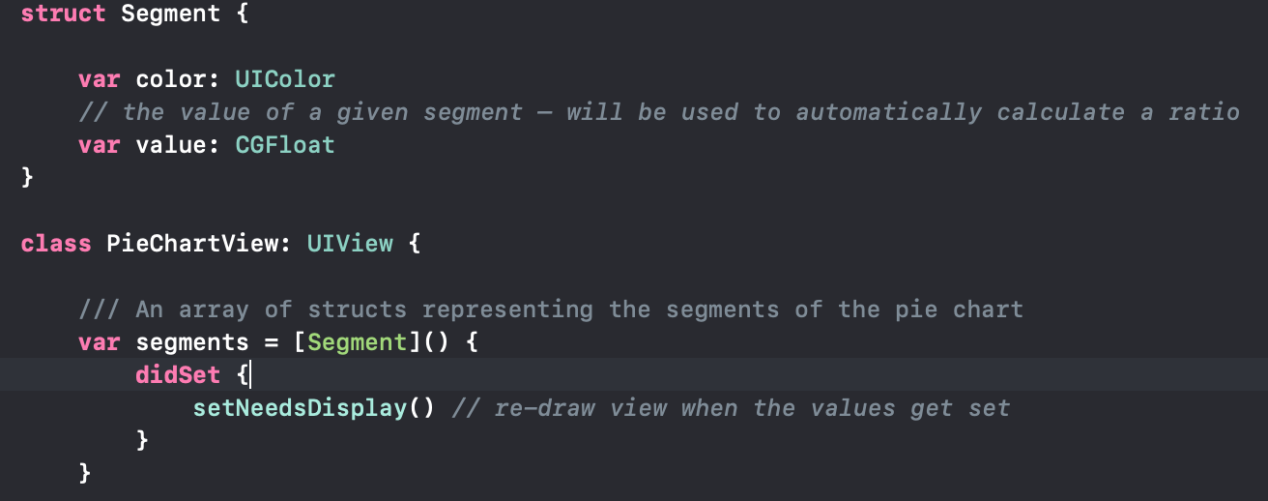
Array of Segment Structs

Slide 9

Implementation - Cocoapods
CocoaPods: Dependency manager

Slide 10
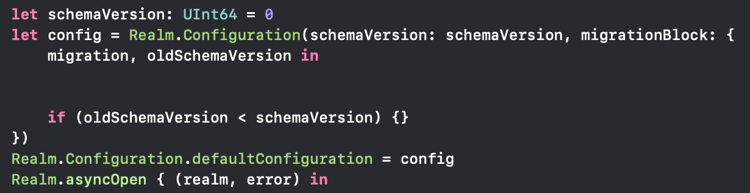
Implementation -
Realm Database
InitializeRealm
Create a Realm Object

Slide 11
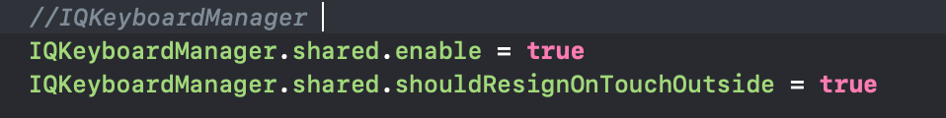
Implementation -
IQKeyBoardManager: To hide Keyboard from TextField
Import to App Delegate

Slide 12
Implementation - MapKit
MKMapType. Standard
MKCoordinateSpan

Slide 13
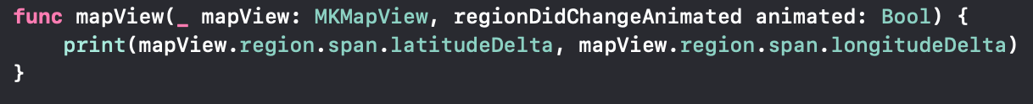
Implementation - MapKit
func mapView
Func LonLatToCity

Slide 14
App Demonstration

Slide 15

What we want to improve
Store data at the server side instead of client side
Edit each records
Better UI design

Slide 16

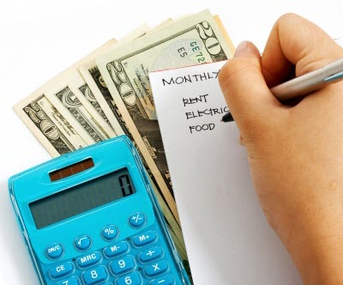
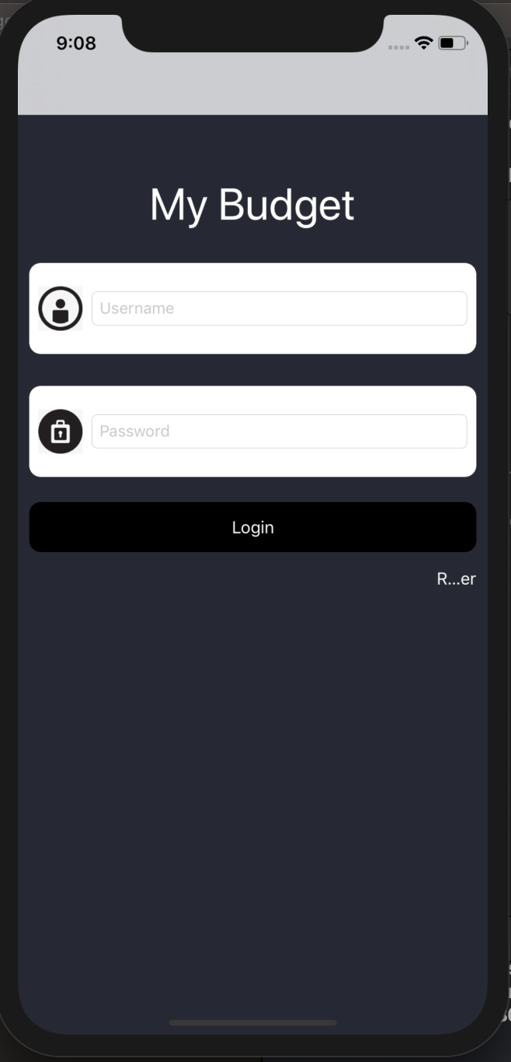

Thanks

